Slide 1


MODULE-5 COLLECTIONS

Slide 2
Course Topics
→ Module 1
» Introduction to Java
→ Module 8
» Servlets
→ Module 2
» Data Handling and Functions
→ Module 9
» JSP
→ Module 3
» Object Oriented Programming in Java
→ Module 10
» Hibernate
→ Module 4
» Packages and Multi-threading
→ Module 11
» Spring
→ Module 5
» Collections
→ Module 12
» Spring, Ajax and Design Patterns
→ Module 6
» XML
→ Module 13
» SOA
→ Module 7
» JDBC
→ Module 14
» Web Services and Project

Slide 3

Objectives
At the end of this module, you will be able to
→ Identify and use important Inbuilt Java Packages like java.lang, java.io, java.util etc.
→ Use Wrapper classes
→ Understand collections framework
→ Implement logic using ArrayList and Vector and Queue
→ Use set, HashSet and TreeSet
→ Implement logic using Map HashMap and Hashtable

Slide 4
Object Level Locking
Object level locking is mechanism when you want to synchronize a non-static method or non-static code block such that only one thread will be able to execute the code block on given instance of the class.
This should always be done to make instance level data thread safe.
public class Dursikshya
{
public synchronized void
demoMethod(){}
}
public class Dursikshya
{
private final Object lock = new
Object();
public void demoMethod(){
synchronized (lock)
{
//other thread safe code
}
}
}
public class Dursikshya
{
public void demoMethod(){
synchronized (this)
{
//other thread safe code
}
}
}

Slide 5
Class Level Locking
Class level locking prevents multiple threads to enter in synchronized block in any of all available instances on runtime. This should always be done to make static data thread safe.
public class Dursikshya
{
public synchronized static
void demoMethod(){}
}
public class Dursikshya
{
private final static Object lock = new
Object();
public void demoMethod(){
synchronized (lock)
{
//other thread safe code
}
}
}
public class Dursikshya
{
public void demoMethod(){
synchronized (Dursikshya.class)
{
//other thread safe code
}
}
}

Slide 6
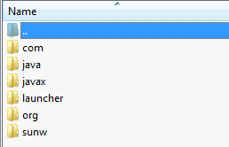
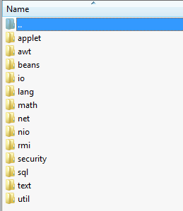
Inbuilt Java Packages
java.io java.lang
Important Inbuilt packages
java.util

Slide 7
java.lang
→ This package provides the classes which are fundamental to Java language.
→ Some of the classes in this package are:
» Byte, Character, Integer, Long, Float – Wrapper classes.
» Math, String, StringBuffer, StringBuilder
» System
» Thread
» Exceptions

Slide 8
java.lang
Math - The class Math contains methods for performing basic numeric operations such as the elementary exponential, logarithm, square root, and trigonometric functions.
String - The String class represents character strings. All string literals in Java programs, such as "abc", are implemented as instances of this class.
StringBuffer - A thread-safe, mutable sequence of characters. A string buffer is like a String, but can be modified. At any point of time, it contains some particular sequence of characters, but the length and content of the sequence can be changed through certain method calls.
StringBuilder - A mutable sequence of characters. This class provides an API compatible with StringBuffer, but with no guarantee of synchronization.
System - The System class contains several useful class fields and methods for standard input, standard output, and error output streams etc. It cannot be instantiated.
Thread - A thread is a thread of execution in a program.
Exceptions - The class Exception and its subclasses are a form of Throwable that indicates conditions that a reasonable application might want to catch.
Note: These classes has been covered in the previous modules

Slide 9
Wrapper Class

Slide 10
Why Wrapper Classes?
→ Since Java is an Object Oriented language, sometimes it is required to send object instead of a primitive data type, in this case wrapper classes object is used.
→ For example, in Collections like ArrayList (You will learn about collections little later in this module) collection classes can only store objects. Here primitive data type can’t be used.
→ If integer or character data is to be stored in collections then it’s corresponding objects are required. Hence wrapper classes are created.

Slide 11



Use Cases - Wrapper Classes
Use Cases, * Dataset/Problem, * Solution of the Dataset/Problem
John takes a laptop from India to USA. There he finds that battery charging pins are different. He will have to find an adapter which works for USA laptops plug points. [He will use the adapter and will charge the laptop] Here the adapter is like a wrapper class.
http://www.primap.com/en/html/maps_-_world.html

Slide 12

John Meets Jack
John meets Jack in a Coffee shop. Jack was John’s classmate in college.
Hi John, how are you? Do you remember me? I am Jack, your friend from College!

Slide 13
John Meets Jack
Hi Jack…I am good. It’s so nice to see you after all these years!! What are you doing these days?

Slide 14

Jack is a Programmer too..
I am working as a Programmer with “Axxizon”. I have managed to learn Java…(laughs).. What about you?

Slide 15

John Talks about his Role..
I was working as a senior programmer and Trainer with “consusis”. I just got a promotion and everything is great!!

Slide 16

Jack needs Help!
Then, I think you are the right person to help me. I have got a project on “Wrapper classes”. I am not aware of it. Can you help me?

Slide 17
Jack needs Help!
Yes sure!!

Slide 18

John explains “Wrapper Class”
Take an example of this chocolate. The manufacturer wraps the chocolate with foil or paper to prevent it from dust. The consumer takes the chocolate, removes and throws the wrapper and then eats it.

Slide 19

John explains “Wrapper Class”
Similarly…..
A Wrapper class wraps a data type and gives it an object appearance. This object can be used wherever, the data type is required as an object. Wrapper classes has methods to unwrap the object and return the data type.
Lets Learn More……….

Slide 20




















More on Wrapper classes
→ Each of Java's eight primitive data types has a class dedicated to it. These are known as wrapper classes, because they "wrap" the primitive data type into an object of that class.
Primitive data type | Wrapper class
byte | Byte
short | Short
Int | Integer
long | Long
float | Float
double | Double
char | Character
boolean | Boolean
Object
Number
Character
Boolean
Byte
Short
Integer
long
Float
Double
Wrapper classes Hierarchy

Slide 21
Where do we use Wrapper class?
In collections, wrapper classes are used for primitive data types.
All the places where primitive data type objects are required, wrapper class is used. How it works?
An integer wrapper class is declared as below:
Integer I = new Integer (10);

Slide 22
Features of Wrapper Classes
→ We can use various class methods like converting integers to string.
→ This is one of the way to store primitive data type into object.
→ valueOf() is available in all the wrapper classes to get the value of given data into the Wrapper class data type.

Slide 23

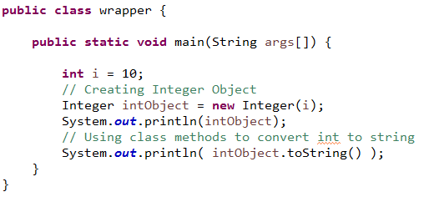
Program on Wrapper Classes
Wrapper class Integer can be used for the primitive data type int.

Slide 24
Java.io
→ This package provides classes to perform IO operations using streams in Java.
→ A stream in Java is a sequence of bytes of undetermined length. It can be compared to water streams.
→ InputStream class can be used to read the data from a data file.
→ OutputStream class can be used to write into a data file.

Slide 25
























java.io - Classes
BufferedReader
LineNumberReader
CharArrayReader
InputStreamReader
FileReader
Reader
FilterReader
PushbackReader
PipedReader
StringReader
BufferedWriter
CharArrayWriter
OutputStreamReader |  | Filewriter
Writer
FilterWriter
PipedWriter
StringWriter
Slide 25
FilterWriter

Slide 26






























java.io - Classes
FileInputStream
LineNumberInputStream
PipedInputStream
DataInputStream
FilterInputStream
BufferedInputStream
InputStream
ByteArrayInputStream
PushbackInputStream
SequenceInputStream
StringBufferInputStream
ObjectInputStream
FileOutputStream
PipedOutputStream
DataOutputStream
OutputStream
FilterOutputStream
BufferedOutputStream
ByteArrayOutputStream
BufferedInputStream
ObjectOutputStream

Slide 27

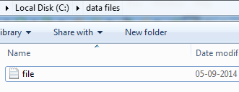
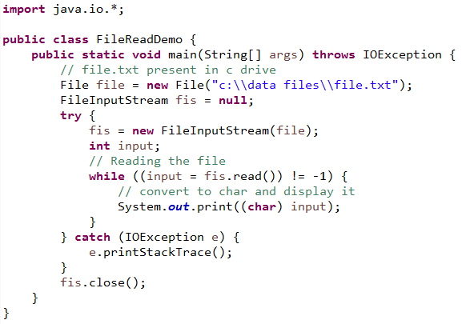

Program to Read a File

Slide 28

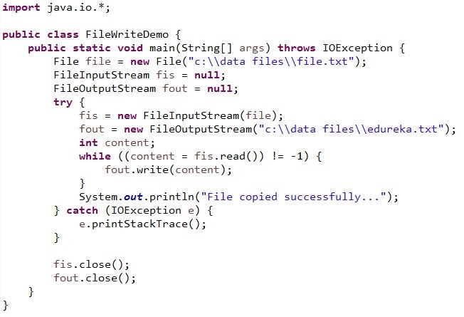

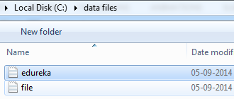

Program to Copy one File to Another
ABC

Slide 29

java.util
Collections are very important in Java programming.
→ This package has all the utility classes required in Java program.
→ All the collection classes which will be discussed in the next slides are part of java.util.
→ Apart from collections, it has following important classes:
» Date
» Scanner

Slide 30

























Collections
Collections: provide set of classes to store and manipulate objects or group of objects.
Iterable
Collection
List
Queue
Set
HashSet
LinkedHashSet
ArrayList
LinkedList
Vector
PriorityQueue
Deque
SortedSet
Stack
ArrayDeque
TreeSet

Slide 31
Collection Classes
Important Collection classes are:
→ ArrayList
→ Vector
→ HashSet
→ TreeSet
→ HashMap
→ Hashtable
→ Properties

Slide 32
Why ArrayList when Array is there?
→ Array is fixed.
→ ArrayList is re-sizeable.

Slide 33









ArrayList
→ ArrayList is the implementation of List Interface.
Java.util.ArrayList
Size:5
→ Array size is fixed but ArrayList size can grow dynamically.
→ ArrayList is used to store objects and perform operations on it.
elementData
0
1
2
3
4
…..
…..
→ ArrayList is not Synchronized. Vector is similar to ArrayList which is synchronized.
If your application does not require insertion or deletion
of elements, the most efficient data structure is the array
John
Carl
Mary
Clark
June

Slide 34
ArrayList (contd.)
→ ArrayList is declared as:
ArrayList <Object to store> ArrayList object = new ArrayList <Object to store> ();
→ The given program stores String objects. Prints all the objects of the ArrayList in new type of array.
→ Removes the string object by name and position and displays the complete collection object.

Slide 35
Methods in ArrayList
→ boolean add(Object e)
→ void add(int index, Object element)
→ boolean addAll(Collection c)
→ Object get(int index)
→ Object set (int index, Object element)
→ Object remove(int index)
→ Iterator iterator()
→ ListIterator listiterator()
→ int indexOf()
→ int lastIndexOf()
→ int index (Object element)
→ int size()
→ void clear()

Slide 36

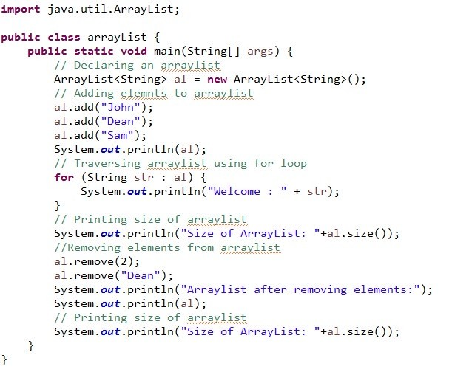
Program on ArrayList

Slide 37
How to trace the elements of ArrayList?
→ For-each loop
→ Iterator
→ ListIterator
→ Enumeration

Slide 38
For-each Loop
→ It’s action is similar to for-loop. It traces through all the elements of array or ArrayList.
→ No need to mention size of ArrayList.
for (String s: arraylist_name)
yword
Ke
name of arraylist
type of data stored in arraylist

Slide 39


Iterator
→ Iterator is an interface that is used to traverse through the elements of collection.
→ It traverses only in forward direction with the help of methods.
Iterator Methods
→ Boolean hasNext()
→ element next()
→ void remove()

Slide 40
Displaying Items Using Iterator
Iterator iterator = arraylist.iterator();
while (iterator. hasNext()) {
Object object = iterator.next(); System.out.print(object + “ “);
}

Slide 41


ListIterator
→ ListIterator is an interface that traverses through the elements of the collection.
→ It traverses in both forward and reverse direction.
ListIterator Methods
→ boolean hasNext()
→ element next()
→ void remove()
→ boolean hasPrevious()
→ element previous()

Slide 42
Displaying Items Using ListIterator
// To modify objects we use ListIterator ListIterator listiterator = arraylist.listIterator();
while (listiterator.hasNext()) {
Object object = listiterator.next(); listiterator.set(“(“ + object + “)”);
}

Slide 43


Enumeration
→ Enumeration is an interface whose action is similar to iterator.
→ But the difference is that it has no method for deleting an element from ArrayList.
Enumeration Methods
→ boolean hasMoreElement()
→ element nextElement()

Slide 44
Displaying Items Using Enumeration
Enumeration enumeration = Collections.enumeration(arraylist);
while (enumeration.hasMoreElements()) {
Object object = enumeration.nextElement(); System.out.print(object + “ “);
}

Slide 45

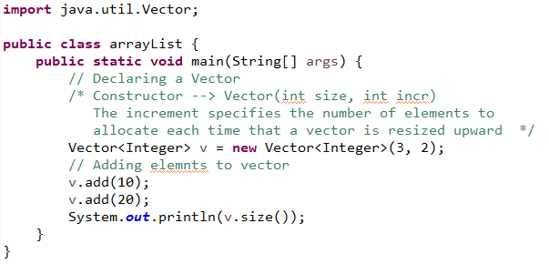
Vector
Vector is same as ArrayList. The only difference is that, Vector is synchronized but ArrayList is not. That means Vector is ThreadSafe.

Slide 46
Queue
→ Queue is an interface.
→ PriorityQueue is a class which implements Queue interface and sorts the data stored.
Deque stands for double ended queue.
→ The queue can be operated at both the ends. Same holds for Insertion and deletion too.
→ Queue operates on the principle of “First in First out”. The element which gets inserted in the beginning is the one which comes out first. The element which gets inserted in the last will come out last.

Slide 47

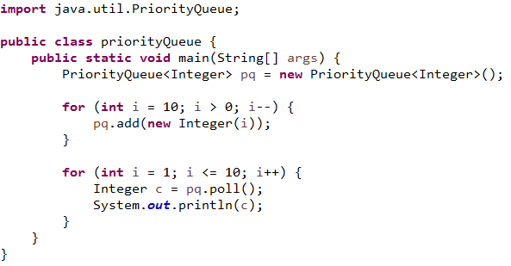
Program on PriorityQueue
This program inserts the data from 10 to 1 in the queue and displays it in a sorted order.

Slide 48



→ A set is a collection interface. HashSet and TreeSet are implemented from Set.
Set
→ Set cannot have duplicates.
→ Class HashSet removes the duplicates and gives better performance over TreeSet. It doesn’t guarantee to store the data in the same order it is inserted.
→ Class TreeSet sorts the added data apart from removing the duplicates.
Set
HashSet LinkedHashSet

Slide 49

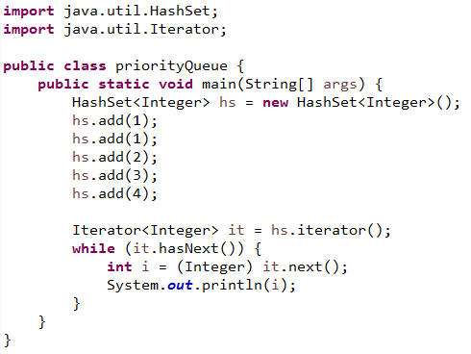
HashSet
This program adds numbers into the HashSet and prints it. You can observe that 1 is inserted twice. As Hashing removes duplicates, it prints 1 only once and removes the second 1.

Slide 50

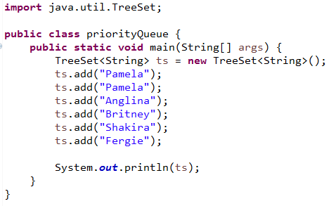
TreeSet
This program adds names, sorts them and displays the names using TreeSet. Observe that Pamela is added twice in the collection. When printed Pamela will be displayed only once as the second entry is removed as duplicate entry by TreeSet.

Slide 51
→ Map is an interface which has key value pair.
Map
→ An object is identied by a key. If key is passed, its corresponding object can be retrieved. It is like in a employee record, employee data is identied by employee id. Employee id is the key and employee data is the object.
→ Some of the important classes of Map are HashMap and Hashtable.

Slide 52




Classes Implementing map Interface
<<interface>> Map
<<interface>> SortedMap
Linked HashMap
Hashtable
HashMap
TreeMap

Slide 53
HashMap
→ Implemented map interface which is used to perform operations such as inserting, deleting and locating elements in a map.
→ HashMap stores data as key value pair.
→ It is unsorted and unordered.
→ It is not synchronized.
→ Map allows one null key and multiple null values
HashMap < K, V >
key value associated with key
key act as indexes and can be any objects

Slide 54
Methods in HashMap
→ Object put(Object key, Object value)
→ Enumeration keys()
→ Enumeration elements()
→ Object get(Object keys)
→ boolean containsKey(Object key)
→ boolean containsValue(Object key)
→ Object remove(Object key)
→ int size()
→ String toString()

Slide 55











HashMap – Abstract View
Key
Value
0
John
1
2
3
4
.
..
…
100
Jack
Linda
Nancy
HashMap
..
….
…….. James

Slide 56
HashMap – Insertion
// Create a hash map
HashMap hashmap = new HashMap();
//Putting elements hashmap.put(“John”, 9634.58);
hashmap.put(“Jack”, 1283.48);
hashmap.put(“Linda”, 1458.10);
hashmap.put(“Nancy”, 199.11);

Slide 57
HashMap – Display
// Get an iterator
Iterator iterator = hashmap.entrySet().iterator();
//Display elements
while (iterator.hasNext()) {
Map.Entry entry = (Map.Entry) iterator.next(); System.out.print(entry.getKey() + “:”); System.out.println(entry.getValue());
}

Slide 58

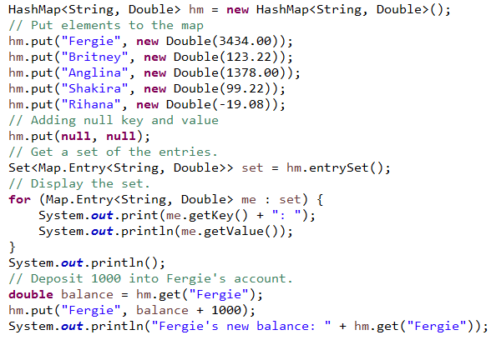
Program on HashMap

Slide 59
Hashtable
→ Hashtable is implemented from map interface which is used to perform operations such as inserting, deleting and locating elements similar to HashMap.
→ Hashtable is Synchronized. That is, it is thread safe.
→ It does not allow null keys or values, if inserted compiler throws NullPointerException.
→ Hashtable stores data as key value pair.
→ It is unsorted and unordered. This is due to hashing.

Slide 60
Methods in Hashtable
→ Object put(Object key, Object Value)
→ Enumeration keys()
→ Enumeration elements()
→ Object get(Object keys)
→ boolean containsKey(Object key)
→ boolean containsValue(Object key)
→ Object remove(Object key)
→ int size()
→ String toString()

Slide 61
Hashtable - Insertion
// Create a hash map
Hashtable hashtable = new Hashtable();
// Putting elements hashtable.put(“John”, 9634.58);
hashtable.put(“Jack”, 1283.48);
hashtable.put(“Linda”, 1478.10);
hashtable.put(“Nancy”, 199.11);

Slide 62
Hashtable - Display
// Using Enumeration
Enumeration enumeration = hashtable.keys();
// Display elements
while (enumeration.hasMoreElements()) {
String key = enumeration.nextElement().toString();
String value = hashtable.get(key).toString(); System.out.println(key + “:”+value);
}

Slide 63

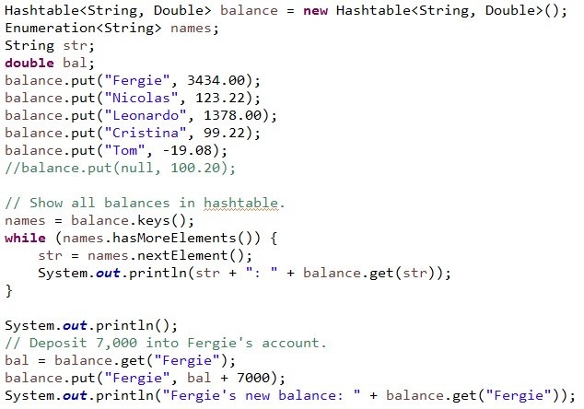
Program on HashMap

Slide 64
Why Use Inner Classes?
Compelling reasons for using nested classes include the following:
→ It is a way of logically grouping classes that are only used in one place: If a class is useful to only one other class, then it is logical to embed it in that class and keep the two together. Nesting such "helper classes" makes their package more streamlined.
→ It increases encapsulation: Consider two top-level classes, A and B, where B needs access to members of A that would otherwise be declared private. By hiding class B within class A, A's members can be declared private and B can access them. In addition, B itself can be hidden from the outside world.
→ It can lead to more readable and maintainable code: Nesting small classes within top-level classes places the code closer to where it is used.

Slide 65

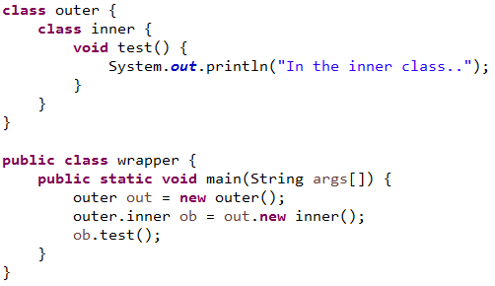
Inner Classes
Sometimes it is required to have an object inside another object in Object Oriented programming. This is possible through inner classes in Java.

Slide 66

QUESTIONS

Slide 67

Assignment - Wrapper Classes
→ Try all the Wrapper classes as shown for Integer.

Slide 68
Assignment in Collections
→ Write a program to insert 1 to 10 numbers in ArrayList and display them.
→ Write a program to write 5 employee records using HashMap and display them.
→ Write a program to write 5 student records into a Hashtable and display the student whose marks are the highest in the class.

Slide 69

Agenda of the Next Class
In the next module, you will be able to:
→ Understand why we need XML?
→ Understand the features of XML
→ Create and use XML files
→ Understand and use DTD
→ Understand XSD and XPath
→ Use XML parsers like SAX and DOM parser
→ Create and use XSL files

Slide 70


Pre-work
Preparation for the next module: Go through XML and its format.

Slide 71
QUESTIONS

